Slide 1






KIRCHHOFF’S CIRCUIT: JUNCTION/CLOSED LOOP RULES
Junction Rule
Current is conserved, no loss of current
At any node, the summation of the current flowing into the node is equal to the summation of currents flowing out of the node
At the node:
Closed Loop Rule
$$∑I_{IN}=∑I_{OUT}$$
$$I_{2}$$
$$I_{1}=I_{2}+I_{3}$$
$$I_{1}$$
$$I_{3}$$
Summation of voltages around any closed circuit is zero
$$∑∆V_{closed loop }=0$$
http://iit.edu/arc/workshops/pdfs/Kirchhoff_s_Circuit_Laws.pdf

Slide 2
KIRCHHOFF’S CIRCUIT: LOOP CONVENTIONS
STEPS:
Assume a loop direction
Assume current direction in every closed loop
Apply junction rule at each node
Apply voltage sign convention (Next Slide)
Assume (+) voltage source if the loop direction flows from (–) to (+)
Assume (–) voltage source if the loop direction flows from (+) to (–)
Assume (+) drop across an element if the loop direction opposes the current direction
Assume (–) drop across an element if the loop direction travels with the current direction

Slide 3
KIRCHHOFF’S CIRCUIT: LOOP CONVENTIONS
http://iit.edu/arc/workshops/pdfs/Kirchhoff_s_Circuit_Laws.pdf

Slide 4

KIRCHHOFF’S CIRCUIT: EXAMPLE
NODE A: $I_{1}+I_{2}=I_{3}$
Loop 1: $10−I_{1}R_{1}−I_{3}R_{3}=0$
Loop 2: $−20+I_{2}R_{2}+I_{3}R_{3}=0$
By substitution:
$I_{1}=−0.143A$
$$I_{2}=0.429A$$
$$I_{3}=I_{1}+I_{2}=0.286A$$
http://iit.edu/arc/workshops/pdfs/Kirchhoff_s_Circuit_Laws.pdf

Slide 5
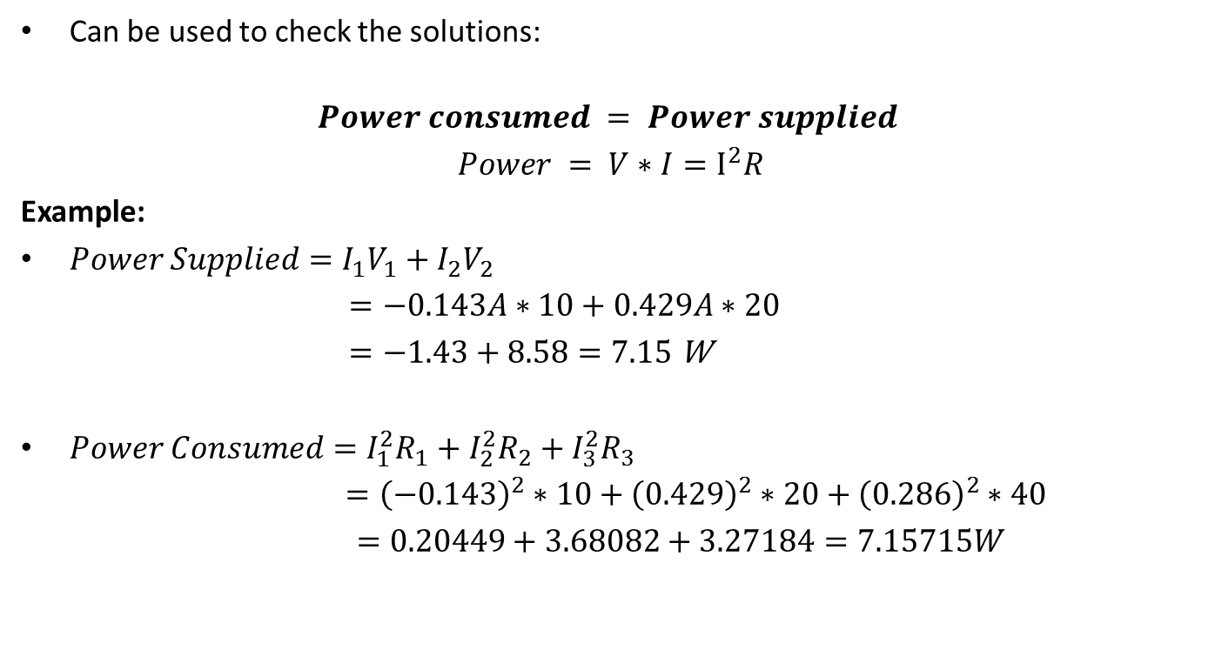
KIRCHHOFF’S CIRCUIT: POWER BALANCE
Can be used to check the solutions:
$$Power consumed = Power supplied$$
$Power = V∗I=I^{2}R$
Example:
$Power Supplied=I_{1}V_{1}+I_{2}V_{2}$
$=−0.143A∗10+0.429A∗20$
$=−1.43+8.58=7.15$ W
$Power Consumed=I_{1}^{2}R_{1}+I_{2}^{2}R_{2}+I_{3}^{2}R_{3}$
$={\left(−0.143\right)}^{2}∗10+{\left(0.429\right)}^{2}∗20+{\left(0.286\right)}^{2}∗40$
$=0.20449+3.68082+3.27184=7.15715W$

